Slide 1
ProductForge
(Course Code: 25CS022)
Presented By:
Piyush Kumar (2411981413)
Pramod Kumar(2411981420)

Slide 2
Index
Introduction
Project Description
System Architecture & Design
Database Design
Data Flow Diagrams (DFD)
Features Implemented
Screenshots
Challenges Faced
Pending Tasks
Conclusion

Slide 3
Introduction
ProductForge: Cloud-Based Digital Product Marketplace and Lifecycle Management Platform
ProductForge is a cloud-based full-stack platform designed to provide a centralized ecosystem for publishing, distributing, selling, updating, and managing software-based digital products.
Problems
Digital creators often depend on different platforms for product publishing, payments, file distribution, version management, customer access, and analytics. ProductForge integrates these activities around a single digital product lifecycle.
Objectives
The objective is to provide creators with one platform for managing digital products from initial publication through releases, commercialization, customer access, updates, and lifecycle tracking.

Slide 4
Project Description
Creator: Creates products, sets pricing, uploads releases, manages versions, and views performance.
Customer: Discovers, purchases/subscribes, accesses products, receives updates, and reviews products.
Admin: Manages users, products, categories, reports, and platform operations.
The main workflow:
The lifecycle:
Authentication, Marketplace, Product Management, Release Management, Commerce, Entitlement, Analytics, Reviews, Notifications
Create
Publish
Discover
Purchase
Access
Update
Analyze
Draft
Beta
Published
v1.0
v1.1
v2.0
Archived

Slide 5
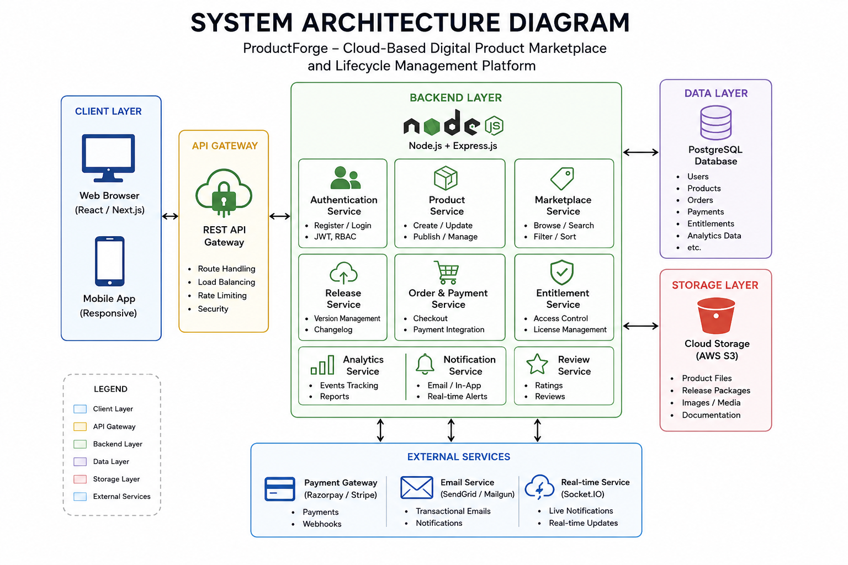
System Architecture & Design

Slide 6
System Architecture & Design
Frontend: React/Next.js interface
REST API
Backend: Node.js + Express
PostgreSQL: users, products, releases, orders, entitlements, reviews, etc.
Cloud Storage: images, product files, release packages
Payment Gateway: transactions/subscriptions
Socket.IO: real-time events

Slide 7
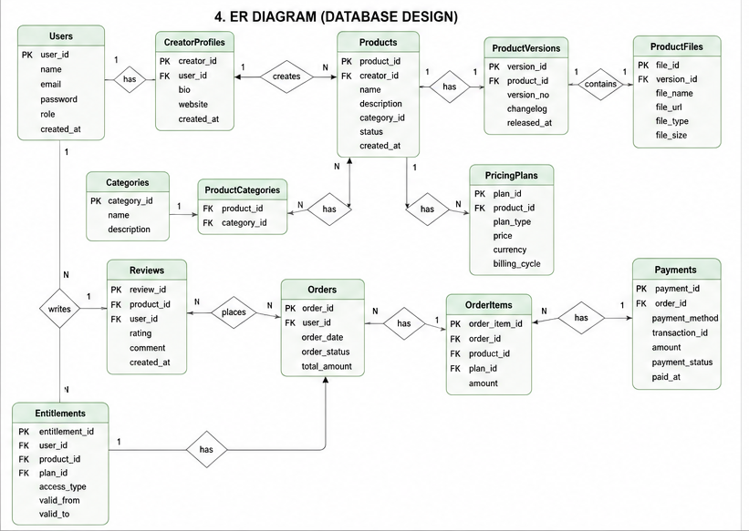
Database Design

Slide 8
Database Design
Creator 1:N Products
Product 1:N ProductVersions
ProductVersion 1:N ProductFiles
Customer 1:N Orders
Order 1:N OrderItems
Customer N:M Products through Entitlements

Slide 9
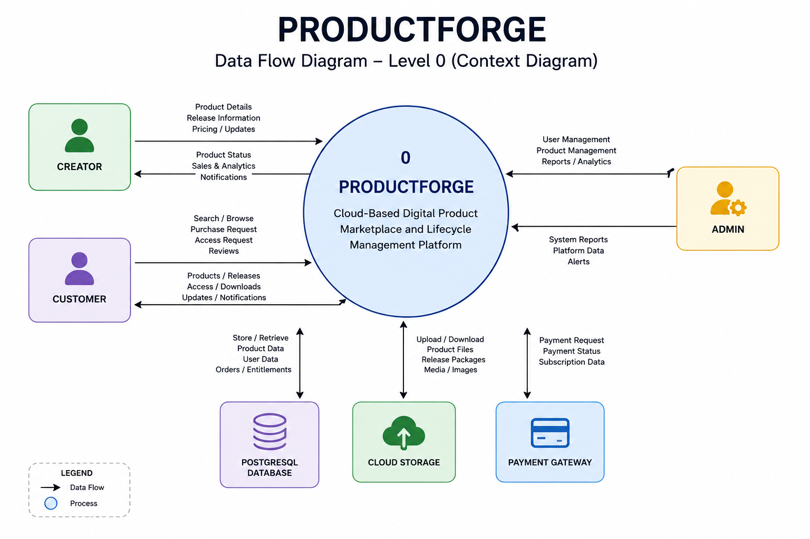
Data Flow Diagrams (DFD)
Level 0 DFD: Overall ProductForge system interacting with Creator, Customer, Admin, database, cloud storage, and payment services.

Slide 10
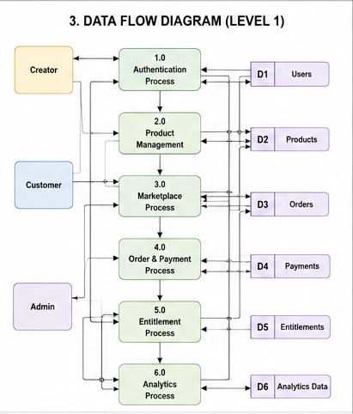
Data Flow Diagrams (DFD)
Level 1 DFD: Break ProductForge into processes such as Authentication, Product Management, Marketplace, Order & Payment, Release Management, Entitlement, and Analytics.

Slide 11
Conclusion
ProductForge is a cloud-based digital product marketplace and lifecycle management platform designed to bring the major stages of managing software-based digital products into a single system. The platform enables creators to create, publish, distribute, sell, update, and manage their products, while customers can discover products, purchase or subscribe to them, access eligible releases, receive updates, and provide feedback.
Unlike a traditional digital marketplace focused mainly on product listing and transactions, ProductForge extends product management beyond the initial sale through version management, release history, customer access control, cloud-based file distribution, analytics, and lifecycle tracking. This creates a continuous connection between creators, their products, releases, and customers.
The project demonstrates practical implementation of full-stack development, relational database design, REST APIs, authentication and authorization, cloud storage, payment integration, and real-time communication. Its modular architecture also allows additional capabilities to be introduced as the platform grows.
Overall, ProductForge aims to provide a centralized, scalable, and efficient ecosystem for managing the complete journey of a digital product, from its initial publication and commercialization to future releases, customer management, growth, and eventual retirement.

Slide 12
Thank You

